Slide 1
State of the World’s Cash Report 2023:
Presentation by Chapter
Cash and Voucher Assistance in Humanitarian Aid

Slide 2
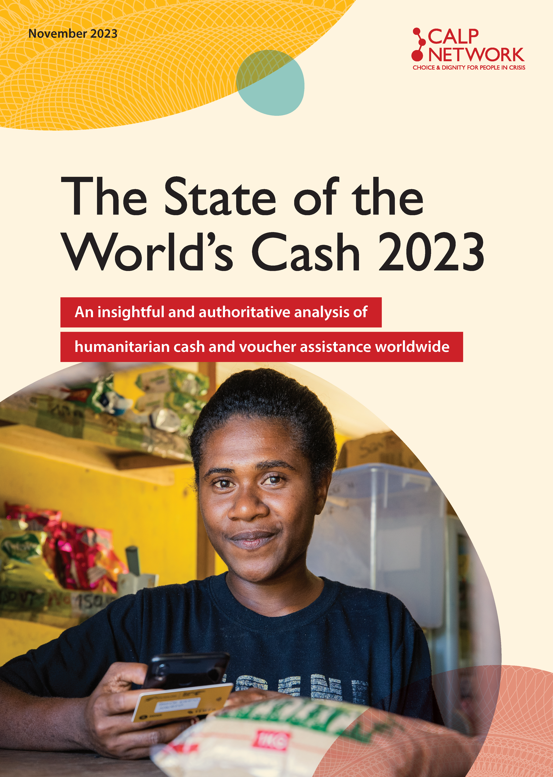
What is the State of the World’s Cash 2023?
A critical analysis of cash and voucher assistance (CVA) globally
An assessment of progress, challenges and opportunities since 2020
Practical actions to support further progress and address challenges
Notes:
This is the third in the series. The first was published in 2018 and the second in 2020.

Slide 3

The Basis of the Report
860 survey responses from CVA practitioners in 4 languages
99 key informant interviews
21 focus group discussions
CVA volume data survey
Extensive literature review
Notes:
Over 1000 people input to the report through surveys, interviews and focus groups.

Slide 4

Chapters
People-centred CVA
CVA volume and growth
Locally led response
Cash coordination
Cash preparedness and capacity
Linkages with Social Protection
Data and digitalization
CVA Design
Climate change and environmental considerations in CVA
© Image: WFP

Slide 5
Chapter 8:
CVA Design
Notes:
This chapter covers the following topics, with consideration of their implications viz the design of CVA programmes:
- Multipurpose Cash Assistance
- Sector-specific CVA
- Complementary Programming
- Financial inclusion

Slide 6

Main Findings
MPC has increased but not to the extent anticipated
Notes:
MPC is frequently central to CVA discussions. As an unrestricted and intentionally multi-purpose form of assistance, MPC is often seen to facilitate greater choice and dignity for crisis-affected people. Stretching back to the Grand Bargain in 2016, much of the emphasis in policy to increase CVA has focused on MPC.
Research suggests that volumes of MPC have increased in line with the growth of CVA overall, but ‘the shift towards MPC has not occurred to the extent anticipated’
The limitations on tracking CVA and other modalities in general means that data does not exist to provide an accurate, consolidated picture of the growth of MPC over time.
Differences across responses in terms of how it has been planned for, and which coordinating body is responsible for tracking its use has further challenged quantification. Although the new cash coordination model outlines the responsibilities of cash working groups (CWGs) on integrating MPC into response plans and processes there is less clarity about tracking and reporting, including the respective responsibilities of CWGs and clusters. A focus group participant noted that reporting on MPC is confusing due to country variations and recommended that the global Cash Advisory Group (CAG) work on this issue.
While data is incomplete, analysis shows that MPC made up 4.1% of total financial requirements in 2022 for FTS-tracked response plans, compared to less than 1% in previous years. This growth is attributable almost entirely to the large MPC requirement for the Ukraine response, where it represented 25% of total funding of the HRP in 20225. By comparison, in Yemen (another large HRP) – despite some increase – MPC only accounted for 3.3% of the total HRP in 20226. Such differences illustrate the wide variations in the use of MPC in different contexts, reflecting variations in the use of CVA in general (MPC and sectoral CVA) across different responses.

Slide 7
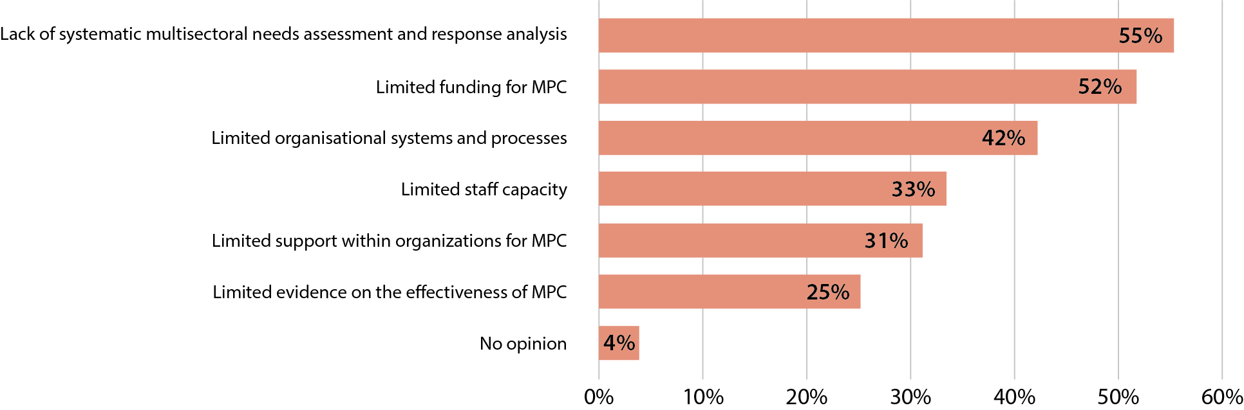
Main Findings
Lack of multisectoral needs assessments and analysis remains a barrier
Perceived Challenges to Increasing MPC
Notes:
Survey respondents perceived the lack of systematic multisectoral needs assessments and response analysis as the largest barrier to increasing MPC, a response that was consistent across all respondent job profiles and regions. This is consistent with other research, with issues related to the lack of multisectoral needs assessment and response analysis identified not only as a barrier to MPC and CVA, but also as a barrier to quality humanitarian action more generally. The need to address this issue featured among the recommendations of previous State of the World’s Cash reports. while the need to improve joint multisector needs assessments was highlighted in the Donor Cash Forum’s Joint Donor Statement and the Grand Bargain (GB).
While recommendations and commitments have been made, expectations of seeing ‘cash programmes planned on the basis of joint and impartial needs assessments ... has only partially been fulfilled’ and highlights that to achieve this ‘would require a more systemic change in the way the humanitarian system operates’ . Some stakeholders anticipate that creating a formal space for cash coordination in the international humanitarian architecture – through the new cash coordination model – will help facilitate more systematic multisectoral assessments and analysis and support a corresponding increase in MPC.
The second, third and fourth largest barriers to MPC identified through the survey were limited funding, limited organizational systems, and limited staff capacities. These barriers correspond with some of the most critical barriers to the uptake of CVA overall and so addressing them is likely to contribute to the growth of MPC and CVA more generally. Perspectives about the greatest opportunities for growth vary; some argue that there is more potential to scale MPC than sectoral CVA as it is MPC that has faced more systematic challenges within sector-oriented response planning and implementation; others argue the opposite and some argue growth opportunities are greater in other areas.

Slide 8
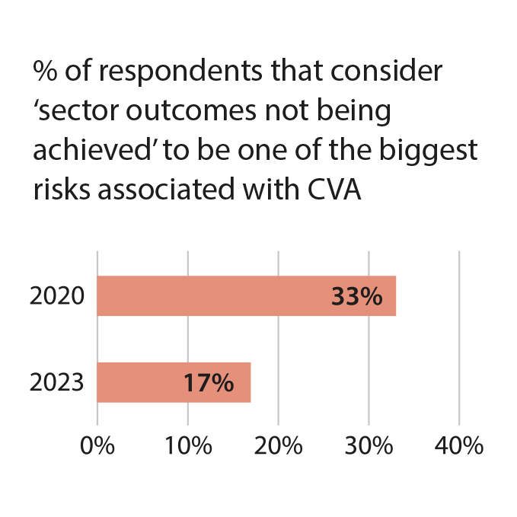
Main Findings
Lack of multisectoral needs assessments and analysis remains a barrier
Concerns remain regarding the extent to which MPC achieves sector-specific outcomes
Notes:
Survey respondents considered evidence of the effectiveness of MPC a less significant barrier than some other factors, but concerns remain regarding the extent to which MPC will achieve sector-specific outcomes (although survey data indicates this has reduced since 2020). Research suggests that questions about where accountability lies for achieving sectoral outcomes has the potential to impede the scale-up of MPC. Further, some sector-focused key informants felt that reporting on the contribution of MPC to sectoral outcomes has not notably improved, with a lack of clarity in some contexts on how interventions are addressing sectoral needs. One key informant remarked that significant increases in MPC might affect how outcomes for crisis-affected people are monitored and evidenced, particularly relative to sector-focused approaches and metrics for success.
Feedback from key informants highlighted several issues beyond those identified in the survey that can directly impact the uptake of MPC at response level, much of which plays out through the interrelations between MPC and sectoral cash. Although there are established definitions for MPC, key informants highlighted that differing understandings remain among both donors and practitioners, with sufficient grey space within the definitions to allow varying applications across different responses Some of these issues relate to differing interpretations of the ‘basic needs’ that MPC can be designed to address, particularly whether MPC is cross-sectoral, or should be broken down and attributed to different sectors. For example, one key informant described regular discussions with sectoral colleagues within their organization with a focus on ‘MPC for what?’. At response level this can play out in struggles to define what is sectoral cash, and what is multi-purpose. Key informants gave the example of Ukraine, where there was clarity that sectoral cash should be designed as a top-up to MPC. However, in many responses the line between MPC and sectoral cash is blurred.
A lack of clarity on remits often contribute to tensions between MPC and sector-specific CVA. Concerns about the technical quality of interventions and achieving specific sectoral outcomes drive these tensions, and, critically, are often associated with questions around funding allocations and influence in response planning processes. These concerns reflect the broader perspective that the growth of MPC calls the current humanitarian coordination architecture into question, with the potential to reduce the role and power of clusters within it.
Some stakeholders, worried about the implications for sectoral budgets, pushed back on the use of MPC, which is not new. It is based in part on concerns that reducing the volume of sector-specific transfers (CVA or in-kind) could also lead to a reduction in resources available for ‘softer’ programming components (e.g., behaviour change, capacity strengthening). These elements of a response are traditionally more challenging to fundraise for as they produce less tangible or immediate outputs but can be essential to achieving certain outcomes. One key informant reported hearing increasing discussions on the merits of ‘going back to sector-specific cash’, particularly from sectors that had been considered more comfortable with MPC, including food security, shelter, and WASH. Much of this seems to hinge on issues related to role legitimacy and funding.
On the other hand, key informants also highlighted progress made in sectors such as health to identify when and how to combine MPC with sectoral CVA and other modalities to better address diverse needs (see below on complementary programming). Key informants also reported increasing interest and acceptance from cluster coordinators on linking with MPC.

Slide 9

Main Findings
The limitations of standardized transfer values are increasingly recognized
Notes:
Several key informants raised the importance of transfer values, usually relating to the growing recognition of the limitations of standardized transfer values that do not take account of diverse needs and household compositions. Key informants highlighted the need for tailoring transfer values to address specific needs, for example using approaches that allow unified/standard transfer values to be topped up with allocations for sectoral or other specific needs. This might include layering or sequencing MPC and sector-specific CVA, and/ or potentially through a case management approach

Slide 10

Main Findings
Some technical processes can hinder rather than support people-centred CVA
Notes:
MEBs frequently play a central role in informing transfer value calculations. Collaborative MEB development processes can potentially provide a platform for more connections between sectoral cash and MPC and create synergies between programmes to maximize outcomes. However, these processes are also inherently technical, if not necessarily highly complex, in nature. In so being, they represent one example of the concern that excessive reliance on technical processes, not least those with such a singular, definitive outcome, may hinder rather than support more people-centred CVA. For example, one key informant noted that different sectors and organizations working with vulnerable groups with specific needs (such as people living with disabilities), often contest MEB processes because they tend to inform universal transfer value decisions that often prove insufficient for those with bespoke needs. Other key informants corroborated this, noting variously that ‘it helps to have a holistic view of need through the MEB, but then it does not always translate into a transfer value that is inclusive’ and ‘an MPC transfer kept at the value of the MEB will not be sufficient for some specific needs’.
The latest MEB Guide to Best Practice highlights the importance of determining how light or heavy an MEB process should be, considering the circumstance and intended use(s). In particular, the guidance draws attention to the need for a process that is designed to make evidence-based decisions on MEB design without being unduly technical, time-consuming or costly. It goes on to provide guidance on including peoples’ priorities into a MEB, bearing in mind that ‘it should ultimately be the affected populations themselves that define what is a priority need’. However, several key informants emphasized that the definition of an MEB should not preclude necessarily bespoke CVA transfer values, especially in protracted crises.

Slide 11

Main Findings
Consideration of CVA has increased across all sectors
Notes:
Overall, there is clear evidence that the use of sector specific CVA could be increased if used appropriately. Pursuing this will require that the relative investment in CVA and in-kind assistance continues to shift towards CVA. Thirty-nine percent (39%) of survey respondents perceived that sectoral CVA represents the largest opportunity to increase the use of CVA as a proportion of overall humanitarian funding.
A focus group discussion with representatives from the Global Education, Food Security, Health, Protection, Nutrition and Shelter Clusters, as well as various key informant interviews, revealed an increased appetite for the routine consideration of CVA as a modality across all sectors, when contextually appropriate. A review of 18 HRPs corroborated this; it showed an increased use, between 2021 and 2022, of CVA as a share of overall activity funding across multiple sectors.
Key informants suggested that the shift towards CVA as a modality during the COVID-19 pandemic and the work on the new cash coordination model likely reinforced, if not altogether drove, these trends. In addition, efforts by such sectors as shelter and WASH to enable the pursuit of Market-Based Programming (MBP), especially through the development of related guidance, are commonly perceived to have contributed positively to CVA uptake in those sectors.
Since 2020, there have been multiple sector-specific research initiatives, culminating in a growing evidence base for the use of CVA for sectoral outcomes. This has gone some way towards filling the evidence gap noted in the State of the World’s Cash reports in both 2018 and 2020 and is perhaps linked to the diminished concerns related to CVA uptake, most notably that sectoral outcomes will not be effectively achieved by using CVA.
The growing evidence base has informed the development of guidance, toolkits, and capacity development materials by various Clusters and individual agencies. In particular, the education, food security, nutrition, protection and WASH sectors have produced or updated toolkits and conducted specific capacity-building initiatives to support Cluster Coordinators in navigating the added complexity of facilitating CVA uptake.
There are also numerous examples of the evolving use of sector-specific CVA. For example, key informants highlighted that cash can play a vital role as part of a holistic response to preventing or responding to Gender-Based Violence (GBV), especially when informed by appropriate response analysis. This has prompted discussions on the optimal duration of CVA and the need to balance the pursuit of scale and cost-efficiency with the need for a case-based approach to respond to the unique protection risks and related assistance needs of highly vulnerable individuals.

Slide 12
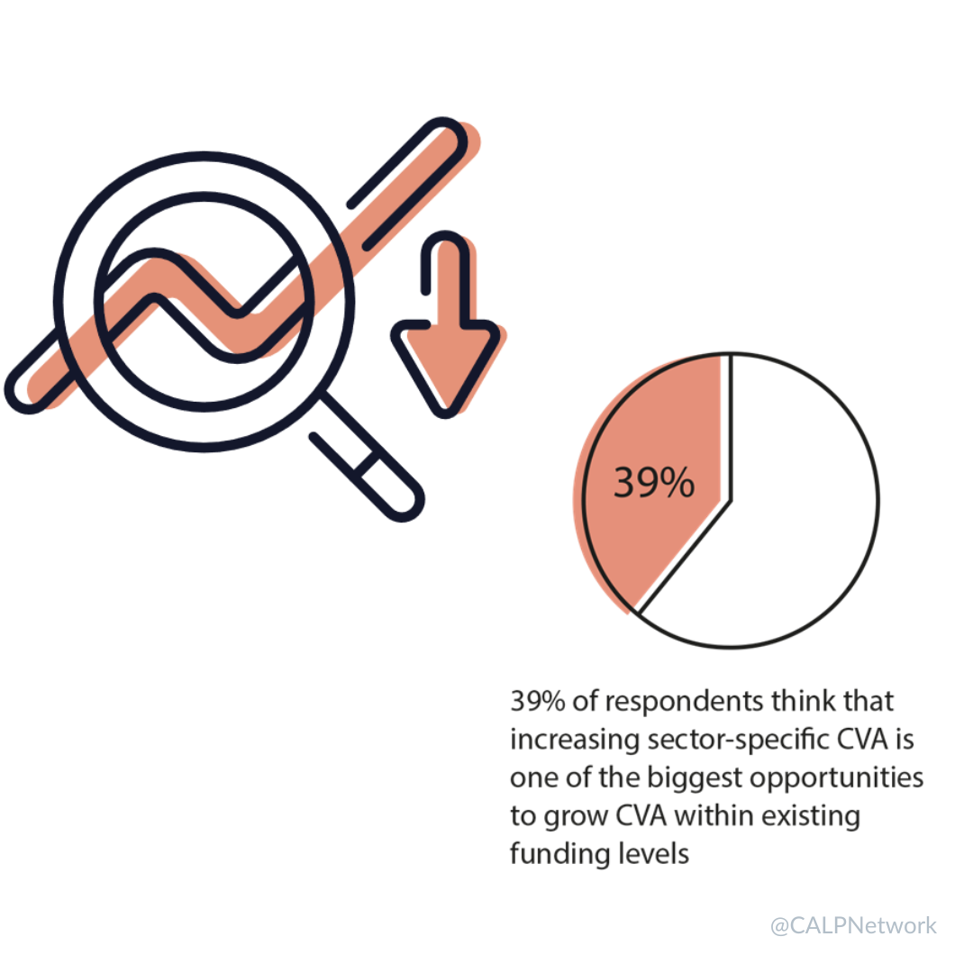
Main Findings
Consideration of CVA has increased across all sectors
Lack of sector-disaggregated CVA data is a barrier to quantifying progress
Notes:
Despite the progress and good practices outlined above, an array of barriers continues to inhibit the increased use of CVA among the sectors. Research shows that the limited amount of sector-disaggregated CVA data is a barrier to further quantifying and encouraging uptake, a fact also reflected in other research on tracking CVA. As a consequence, there is often a lack of clarity on whether the use of CVA has increased in absolute or relative terms – including by some sector cash specialists.

Slide 13

Main Findings
Consideration of CVA has increased across all sectors
Lack of sector-disaggregated CVA data is a barrier to quantifying progress
Modality choices influenced by habits, perceptions, organizational inertia and donor preferences
Notes:
Recent research, supported by key informants’ feedback, shows that, despite mounting evidence on the achievement of sectoral outcomes with CVA and the growing use of MPC to meet basic needs, individual habits, perceived complexity of ‘new’ approaches, organizational inertia and donor preferences (either real or perceived) unduly influence sector-specific modality choices. This inertia to change is widely evident, even in the food security sector, where the ‘burden of proof’ has been shifting in favour of CVA for some time. As a result, the default modality still often leans towards in-kind, at both organizational and (in some cases) at response level, despite the widely recognized flaws of arbitrary deference to in-kind.
While inertia inhibits progress in many cases, there are many important concerns that have limited the use of CVA in some sectoral contexts. For example, the global Food Security Cluster’s recent report on CVA in contexts of acute food insecurity concluded that, despite progress and the relative prevalence of CVA in the sector, it is still falling short of its potential. While drawing attention to how individual habits, past modality choices and funding streams earmarked to in-kind delivery have impacted modality decision-making, it also highlights examples of governments restricting the use of cash for food security in areas where they have limited control and where there is a high presence of non-state armed groups. Some responses from key informants, supported this, noting that contextual barriers to CVA, including government action, can impact modality decisions.
Key informants noted that CVA counterparts often lack sufficient awareness of sector-specific dilemmas regarding the use of CVA. For example, a health practitioner, emphasized that a lack of systematic analysis of the barriers to quality healthcare still hamper the wider use of cash to meet health needs. Identifying these barriers (e.g. financial, physical, social) was considered paramount to designing integrated programmes, inclusive of CVA as relevant, to overcome them effectively.
Despite, or indeed because of these barriers, several opportunities have been identified to increase the uptake of sector-specific CVA. One key informant noted the opportunity of adopting a ‘can do’ attitude and expanding pilots of sector-specific CVA, helping address perceived or actual lack of evidence supporting effectiveness.

Slide 14
Strategic Debates
Can an effective relationship between sectoral programming and MPC be developed?
How should technical priorities be balanced with recipient preferences?
Can CVA be designed to facilitate financial inclusion?
Notes:
How can more effective relationships between sectoral programming and MPC be developed? Despite some progress over the years, the interrelationships between MPC and sectoral programming are still frequently contested, particularly concerning resource allocations and the achievement of respective outcomes. The lack of consistent or standardized approach to the design and coordination of MPC, including in relation to sectoral CVA, has contributed to these tensions. There is some optimism that the new cash coordination model, with its formalized place in the humanitarian system, will provide opportunities to better address this issue. The global Cash Advisory Group has been tasked with developing guidance on MPC for the 2024 HRP cycle. However, given the differing perspectives on how cash would be most effectively deployed in terms of MPC and/or sector-specific CVA, easy or generalizable solutions are not likely to be forthcoming.
Can a balance be struck between technical priorities and people’s preferences when designing complementary interventions, particularly in under-resourced responses? The rationale for complementary programming is compelling, with some arguing that this should be the default approach to intervention design. One note of caution is in ensuring people’s preferences are given necessary weight alongside the technical priorities of implementing agencies in the design of complementary programming. Determining which combinations of assistance are most effective, and the relative costs of implementing them, requires a willingness to experiment, based on sound analysis, to generate evidence. For example, where relevant this should show that additional costs for complementary activities do not compromise the adequacy of the cash transfer to the detriment of the overall impact. This may include recognizing where complementary activities are not required, and maximizing cash transfers, for example, is the best option. These issues may be more acutely felt in more resource constrained responses.
How can CVA be designed to better facilitate financial inclusion, including incorporating informal and community-based mechanisms? The potential use of CVA as a springboard to financial inclusion has consistently been shown to depend on a suitable operational context and target group, and a tailored programme design. In many crisis-affected contexts, there are supply and/or demand-side challenges to this. Financial inclusion is frequently defined, implicitly, or explicitly, in terms of engagement with formal financial institutions and services. Within CVA this makes sense to the extent that the entry point for financial inclusion is usually via payment solutions from formal FSPs. However, in many contexts, different formal structures – such as micro-finance institutions – as well as informal and community-based mechanisms play a critical role in people’s financial management and service access, although engaging with these mechanisms typically falls outside the scope of humanitarian response as the system is currently structured. With greater focus on locally-led response, there is need for more focus on the opportunities to strengthen responses by working with different mechanisms and giving more focus to ‘bottom up’ financial inclusion. Designing CVA to support financial inclusion, building on informal and formal mechanisms, should recognize the need to navigate different ways of working between large-scale CVA and working with VSLAs, for example. One function could be in finding opportunities for ‘bridging the gap between formal and informal access to finance’, which has been shown to ‘boost financial inclusion and financial health’

Slide 15
Priority Actions
Humanitarian actors should track sectoral CVA and MPC, to better understand assistance.
Operational agencies, CWGs and clusters should engage in multisectoral assessment and analysis processes.
Sectoral stakeholders should increase cross-sectoral learning to overcome barriers to the uptake of CVA.
CWGs and clusters should use MEB processes to facilitate understanding between sectors and cash actors, avoiding overly technical processes that risk not supporting people-centred CVA.
Humanitarian actors should use agreed metrics and tools to monitor and evaluate MPC and sector-specific CVA.
CWGs, donors and intersectoral and sectoral representatives should agree guidelines on the respective functions of and relationships between MPC and sector-specific CVA.
Humanitarian actors should assess the effectiveness of complementary programming.
Humanitarian actors should incorporate feasibility analysis for financial inclusion into design.
Notes:
Humanitarian actors, including operational agencies, CWGs and clusters, should encourage and adopt systematic tracking of sectoral CVA and MPC. The lack of reliable and publicly accessible data limits the quantification, monitoring and coordination of both MPC and sectoral cash. While not a panacea for associated challenges, better data could help identify and address some barriers and enable more effective evaluation of the types of assistance provided, where, and the relative impacts.
Operational agencies, CWGs and clusters should encourage and engage in multisectoral assessment and analysis processes, including the roll-out of the JIAF 2.0. Such joint processes have been consistently identified as critical to facilitating greater and more effective uptake of both MPC and sectoral CVA, including combined with complementary activities.
Sectoral stakeholders and others working to support the effective use of CVA for sectoral outcomes should identify and explore opportunities for more cross-sectoral engagement to help overcome common barriers to the uptake of CVA. This can be done with an appreciation of the specificities of the use of CVA in different sectors.
CWGs and clusters should aim to use MEB processes to their full potential to facilitate more collaboration and understanding between sectors and cash actors. This has the potential to be used as a springboard to ongoing collaboration in assessments and analysis, and the development of better cross-response synergies in programme design. At the same time, CWGs and clusters should avoid unduly technical, time-consuming and costly MEB processes that risk hindering rather than supporting people-centred CVA.
Humanitarian actors should continue to make use of jointly developed metrics and tools for monitoring and evaluating the impacts of both MPC and sector-specific CVA. It is also important to engage in efforts to share and/or consolidate results to both better understand the outcomes of different interventions and identify where improvements are required to metrics and tools.
CWGs, donors, and relevant intersectoral and sectoral representatives should work together to agree guidelines on the respective functions of and relationships between MPC and sector-specific CVA, building on what is already outlined in the new cash coordination model. So far as possible, this should happen in advance of or at the outset of a response. Ideally it would follow a similar approach across responses, but in practical terms will likely be tailored to a given response and/or country, including in terms of linkages to social assistance and cash-based anticipatory action.
Humanitarian actors should systematically explore and document the effectiveness of different combinations of activities (i.e., complementary programming) with regards to various outcomes. The objective should be to maximize outcomes and synergies between programmes to achieve impacts that are greater than the sum of the constituent parts, including identifying and investing in effective referral mechanisms.
Humanitarian actors should systematically incorporate feasibility analysis for financial inclusion (opportunities and challenges) into CVA design (and funding) processes, and gather and document evidence of the outcomes where relevant. This should include both formal and informal financial services and mechanisms. To initiate that process, humanitarian actors could start by engaging with key stakeholders including local communities, formal and informal financial organizations, and relevant regulators, to ensure a comprehensive understanding of the financial landscape and opportunities. Another engagement could be to conduct an in-depth contextual analysis to assess the specific financial needs, preferences, and challenges of the target population in a given humanitarian setting.

